Slide 1



PRODUCT CATALOGUE AND CUSTOMER SUPPORT FOR PLYWOOD & GLASS BUSINESS
PROJECT GUIDE
Dr.M.VIMALADEVI
ASSOCIATE PROFESSOR/AI
PROJECT MEMBER
PADMAPRIYA R – 22ALR063
RASHMIKA K R – 22ALR076
RITHIK CHANDRASEKAR – 22ALR081

Slide 2
COMPANY DETAILS
SHOP NAME : Rakesh glass and plywood
SHOP OWNER NAME : Rakesh
MAIL ID : rakeshkgm23@gmail.com
ADDRESS : 28-c nandhini complex kovai road kangeyam -638 701
PHONE NUMBER : 9944962351,9952179391

Slide 3
PROBLEM STATEMENT
The plywood and glass industry faces challenges like inventory mismanagement, inaccurate stock tracking, delayed orders, and limited online presence. With diverse products such as plywood, glass panels, and laminates, real-time stock visibility and efficient customer engagement are crucial. Manual processes often lead to stock mismatches, missed sales, and operational inefficiencies, highlighting the need for a digital solution.

Slide 4
ABSTRACT
The project aims to digitize Rakesh Glass & Plywoods by building a modern platform using the MERN stack (MongoDB, Express.js, ReactJS, Node.js).
It showcases a wide variety of plywood and glass products with detailed specs and high-resolution images.
The ReactJS frontend ensures a smooth, interactive user experience.
Node.js and Express.js handle backend operations, while MongoDB Atlas stores product data in the cloud. This digital shift enhances product visibility and sets the stage for future features like inquiries and order management.

Slide 5
OBJECTIVE
Enhance Online Presence
Create a professional website for better accessibility.
Streamline Product Display
Organize and categorize products for easy browsing.
Improve Customer Engagement
Enable inquiries and contact forms.
Optimize Business Operations
Provide location, contact details, and working hours.
Boost Sales & Visibility
Increase brand awareness and attract customers.

Slide 6
EXISTING SYSTEM
From the requirement analysis, it is evident that there is currently no digital system in place for managing plywood products. The business relies on a manual record-keeping method, which is time-consuming, inefficient, and susceptible to errors. The introduction of a digital Product Catalogue platform will streamline product management, enhance operational efficiency, and significantly reduce the risk of manual mistakes. By adopting this system, the business will be better equipped to organize, update, and display its plywood offerings—ultimately improving productivity and supporting future growth.
PROPOSED SYSTEM
The increasing preference for online shopping among consumers necessitates the establishment of a digital presence to remain competitive and relevant in the retail industry.
Embracing e-commerce, "Product Catalogue" can overcome geographical limitations and tap into new markets, thereby expanding its customer base and revenue potential.
An online store offers unparalleled convenience to customers, allowing them to browse, select, and purchase products from the comfort of their homes or on the go, 24/7.

Slide 7
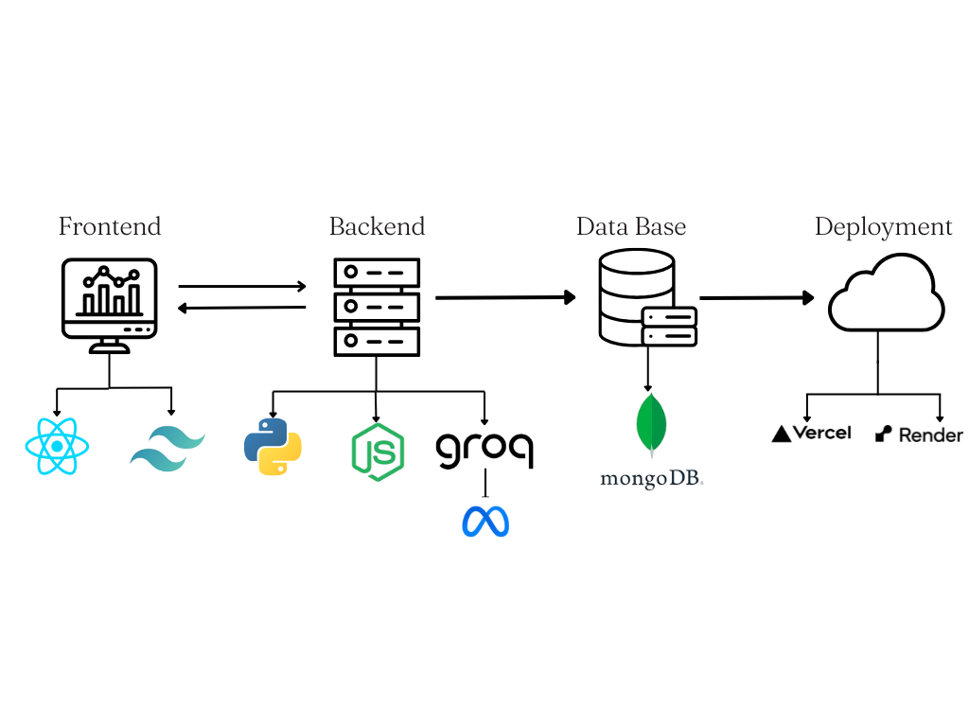
TECH STACK

Slide 8
MODULES USED
The project contains two modules as follows and their description as given below.
● User module
● Admin module
The User Module is designed to enhance the browsing experience for customers, to explore products and interact with the company.
Key Pages:
● Home Page – A welcoming interface providing access to all other pages.
● Contact Us Page – Enables customers to get in touch with the business via a contact form and direct details.
● Enquiry Page – Allows users to submit product or service-related queries quickly.
● WoodCalc Page – Lets users estimate material cost based on type, dimensions, and quantity.
● Chatbot Interface – A bilingual chatbot (English and Tamil) that guides users with product info, navigation, and inquiries.
● WhatsApp Integration – Directs users to WhatsApp for real-time communication and support.

Slide 9
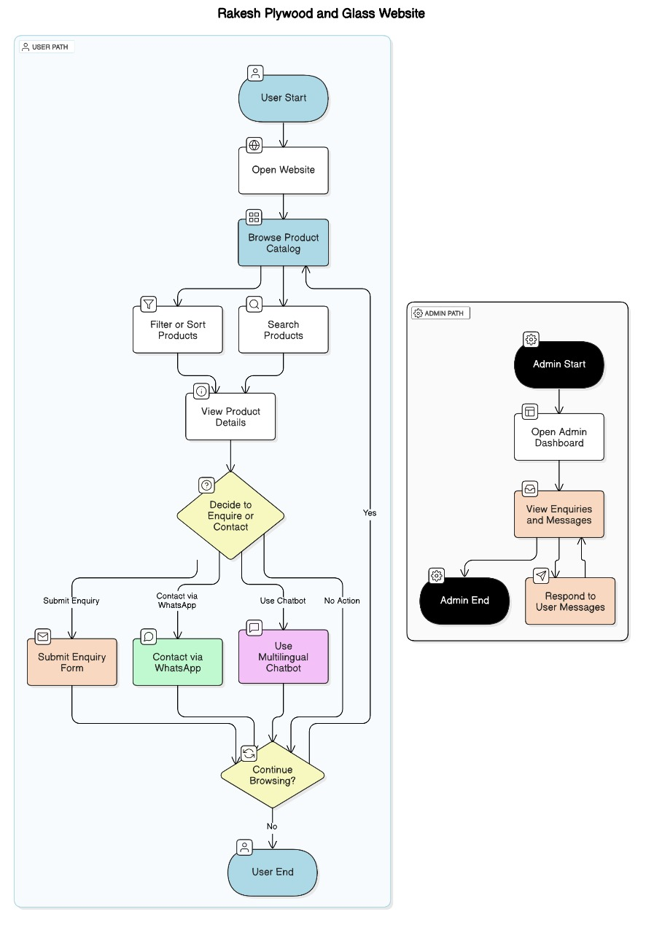
PROJECT OVERVIEW

Slide 10
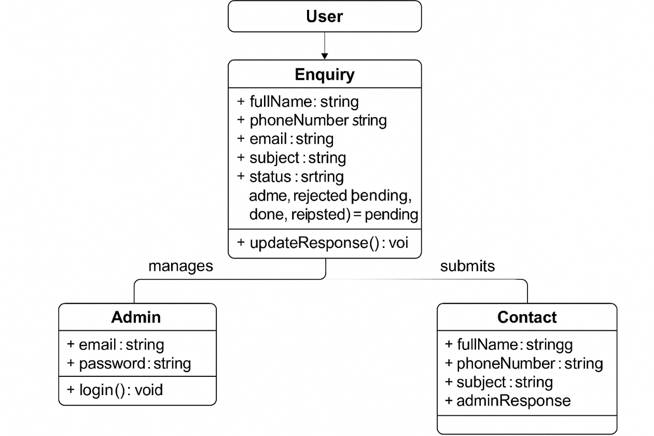
MONGODB SCHEMA OVERVIEW

Slide 11
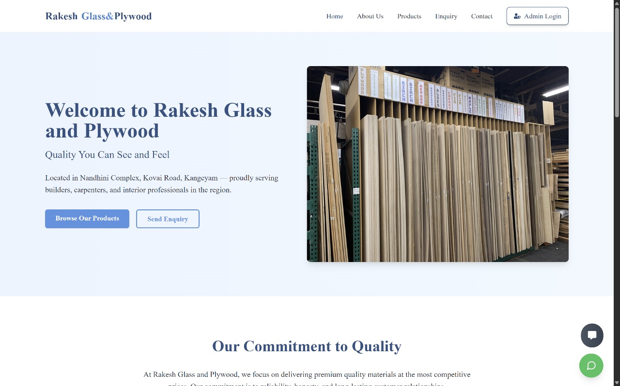
PROJECT IMPLEMENTATION SCREENSHOTS

Slide 12
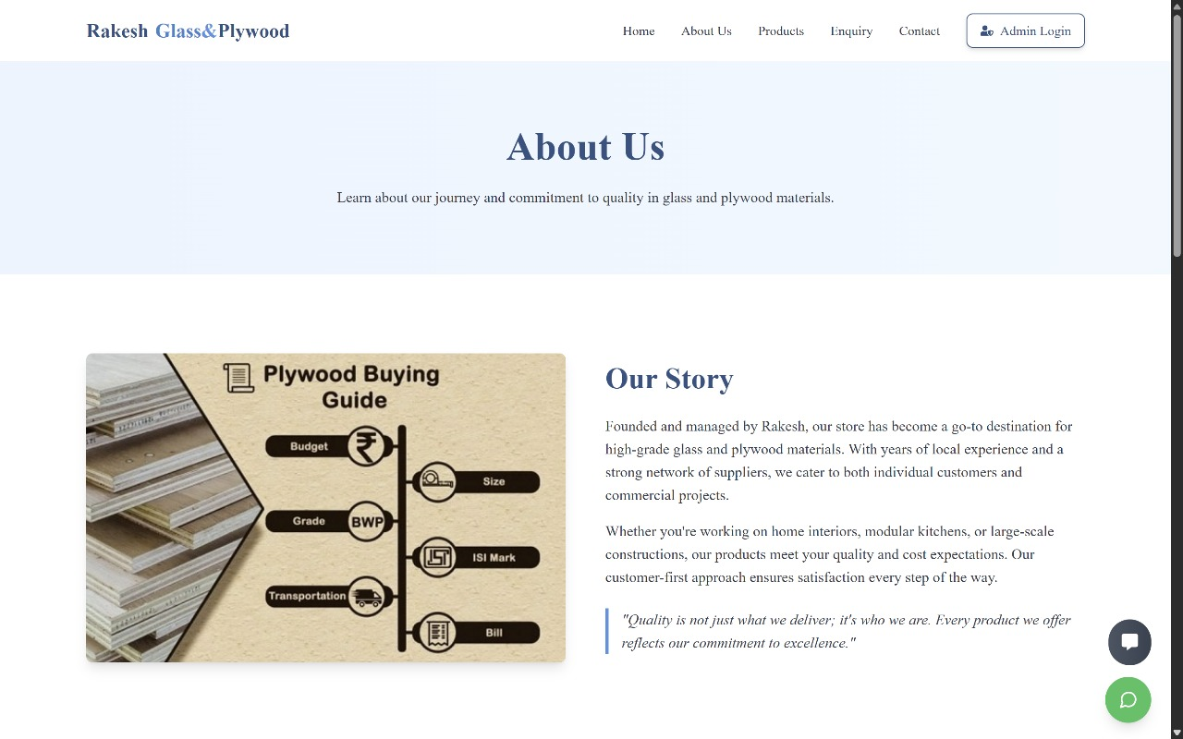

Slide 13
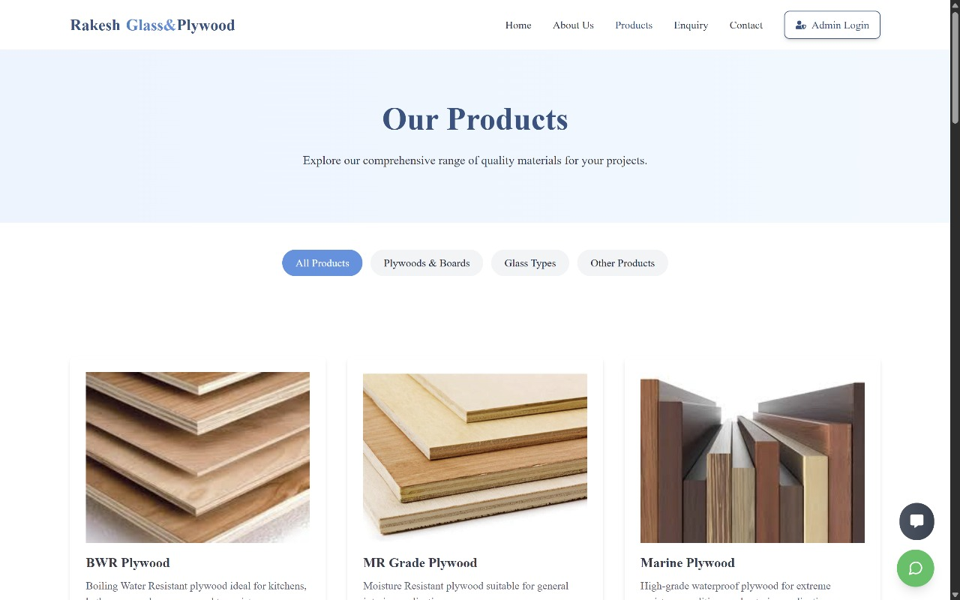

Slide 14
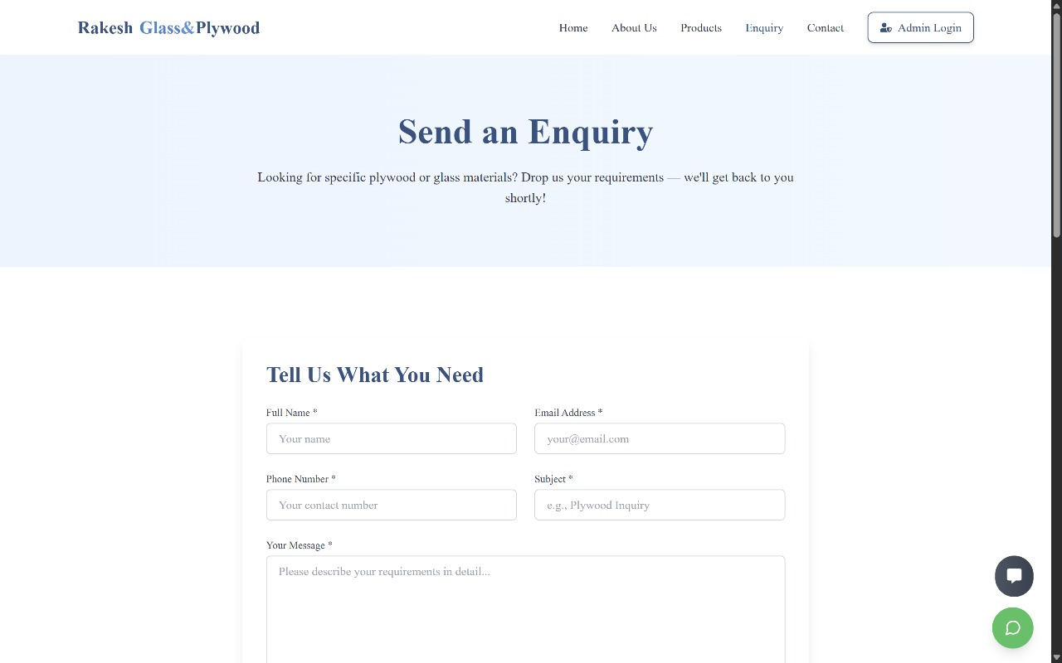

Slide 15
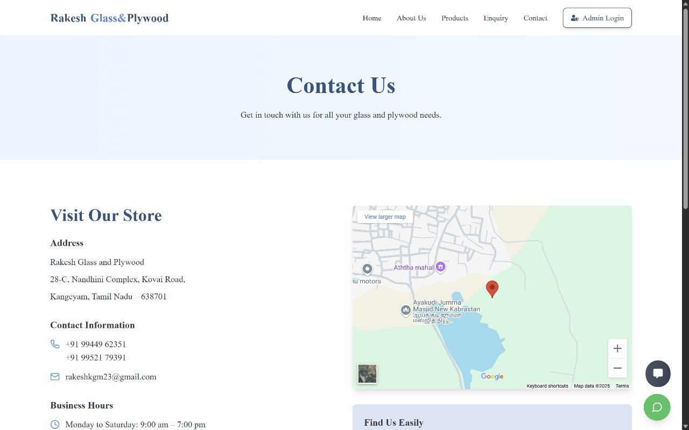

Slide 16
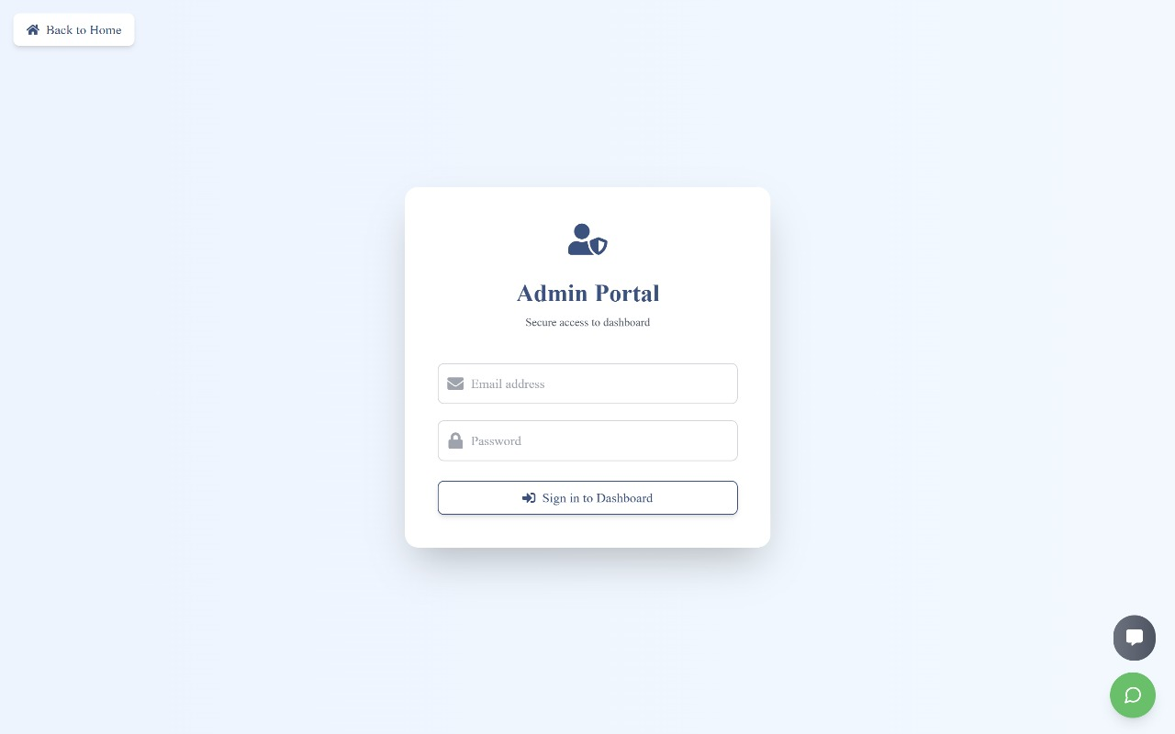

Slide 17
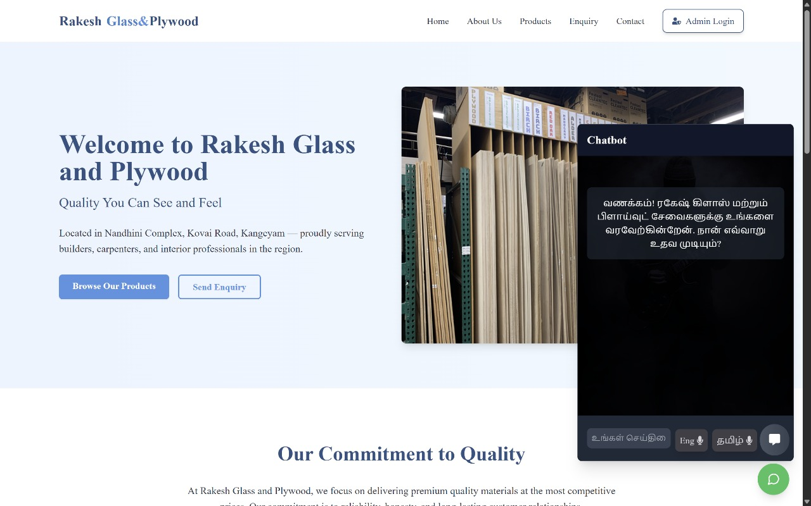

Slide 18
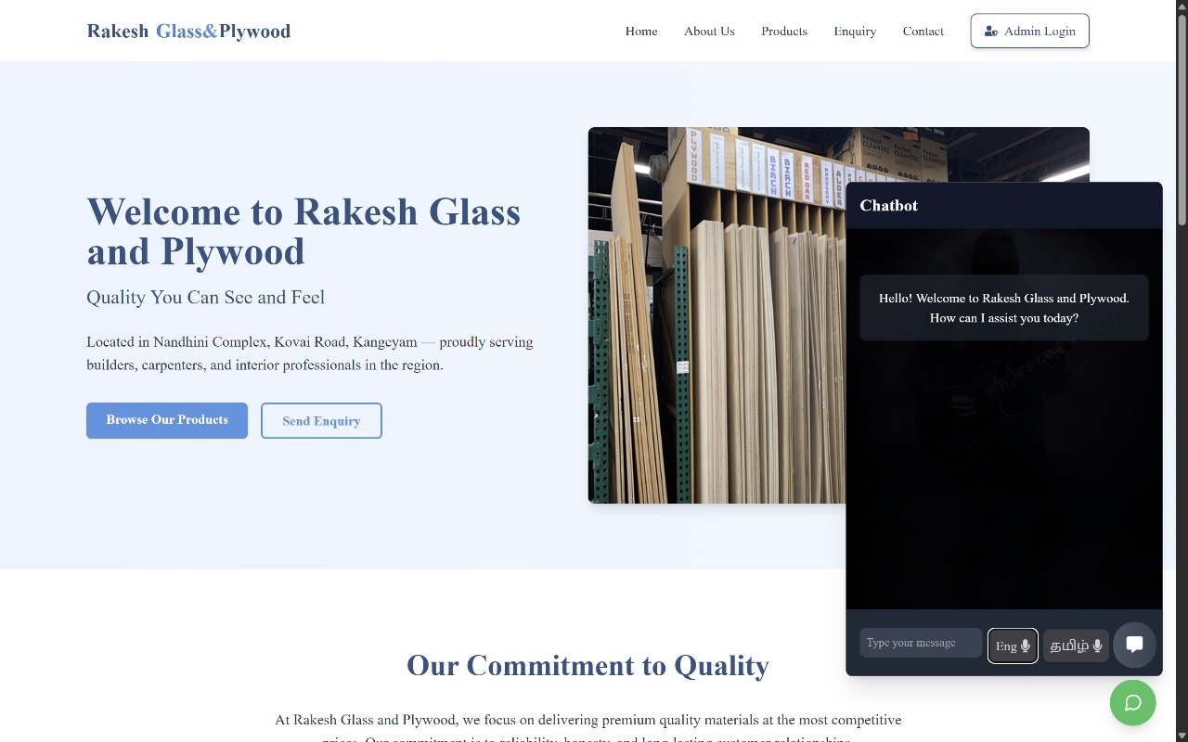

Slide 19
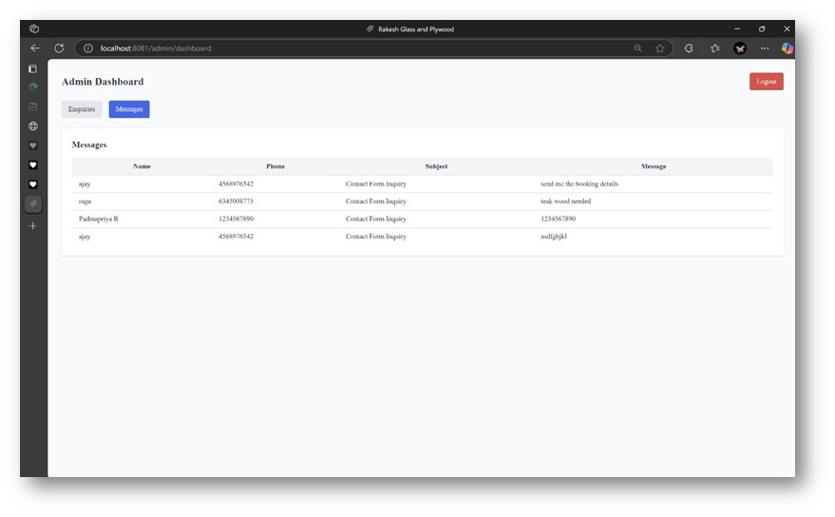

Slide 20
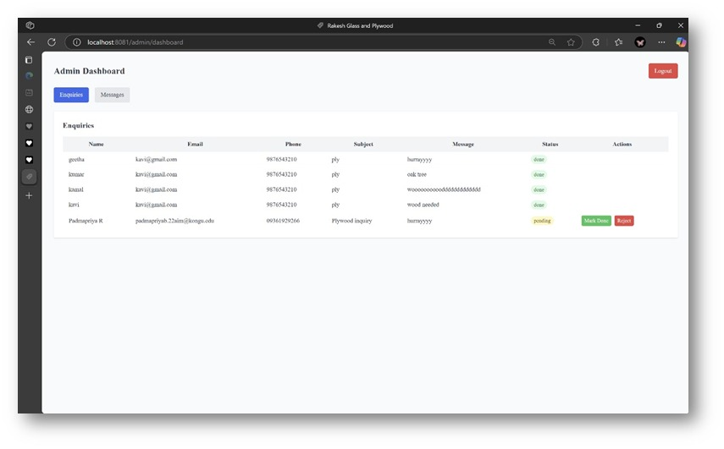

Slide 21
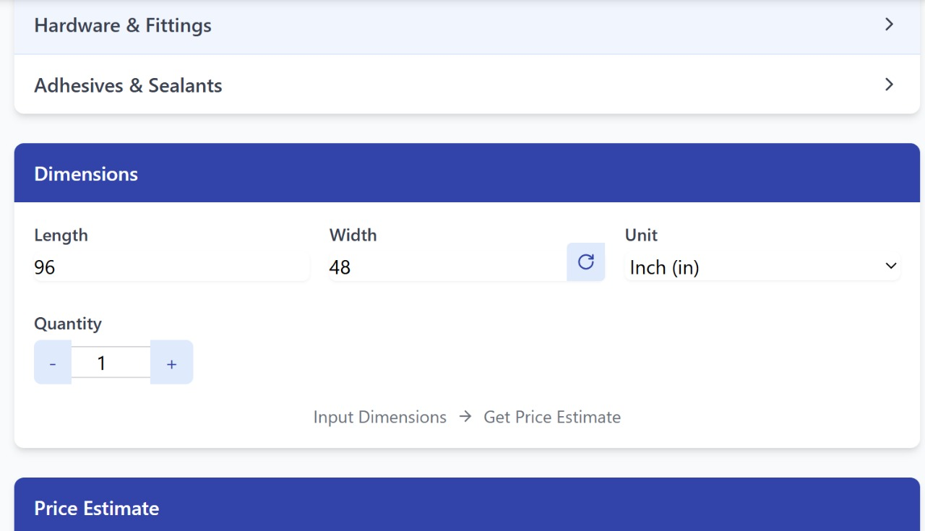

Slide 22
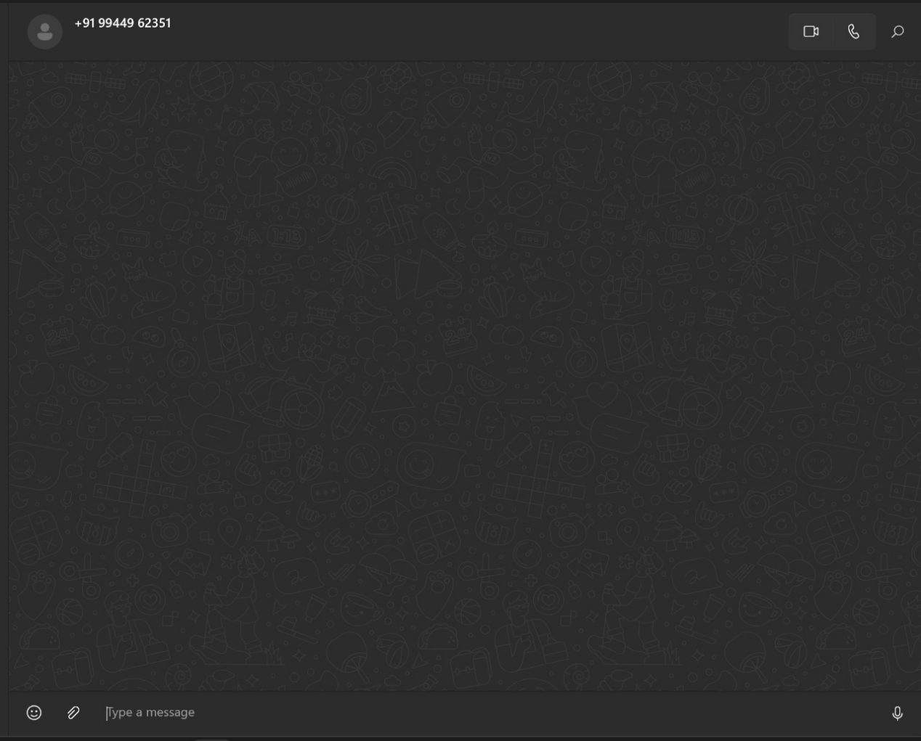

Slide 23
CONCLUSION AND FUTURE ENHANCEMENT
Live Enquiry Tracking: Allowing customers to view the status of their enquiries in real time through their account dashboard.
Push Notifications for Admin: Implementing instant notifications via email or SMS to alert the admin of new customer enquiries and orders for faster response times.
Mobile Application Development: Introducing a mobile app for seamless product browsing, enquiry management, and customer interaction on the go.
Online Payment Integration: Adding secure digital payment options to support direct order placements and advance booking through the platform.
Advanced Analytics Dashboard: Introduce admin-side analytics to monitor user activity, and enquiry trends for data-driven decision making.

Slide 24
LITERATURE SURVEY
Developing an Inventory Management Application Using MERN Stack – Lubna Rasel (2024) Focuses on building inventory systems with MERN stack.
Web-Based Online Inventory Information System– Soegoto & Palalungan (2020) Discusses web-based inventory systems for business efficiency.
Inventory Management System – IJCRT.org (2022) Explores MERN stack for scalable inventory solutions.
SMRT Inventory Management System– IJNRD (2024) Highlights real-time data processing in inventory systems.
An Improved Web-Based Inventory Management System – EUDL (2023) Addresses challenges like overstocking in web-based systems.

Slide 25
THANK YOU

